Slide 1
What Data Will Be Collected?

Slide 2
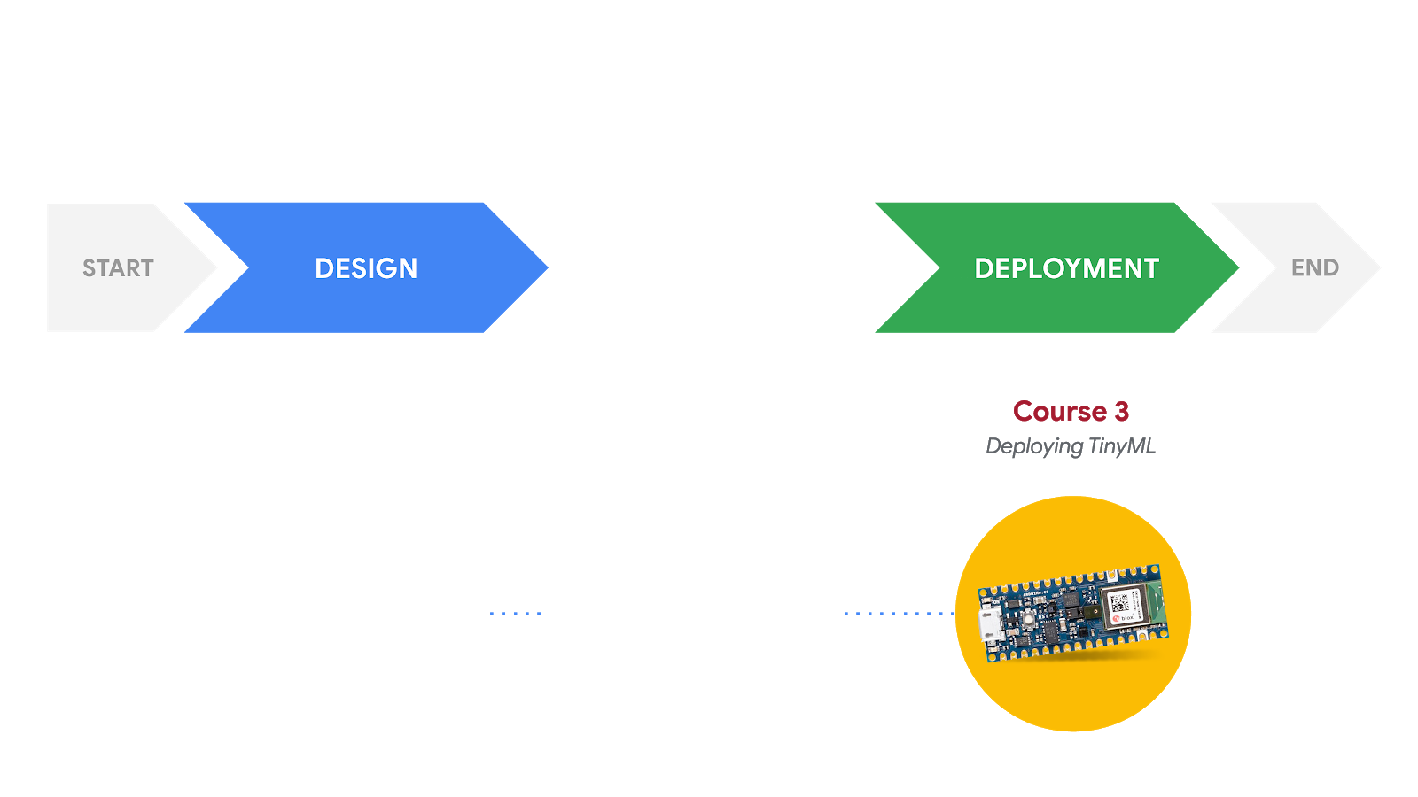
Responsible AI: Human-Centered Design
DEVELOPMENT
Course 1
Fundamentals of TinyML
Course 2
Applications of TinyML
What am I building?
Who am I building this for?
What are the consequences for the user if it fails?
What data will be collected to train the model?
Is the dataset biased?
How can we ensure the model is fair?

Slide 3
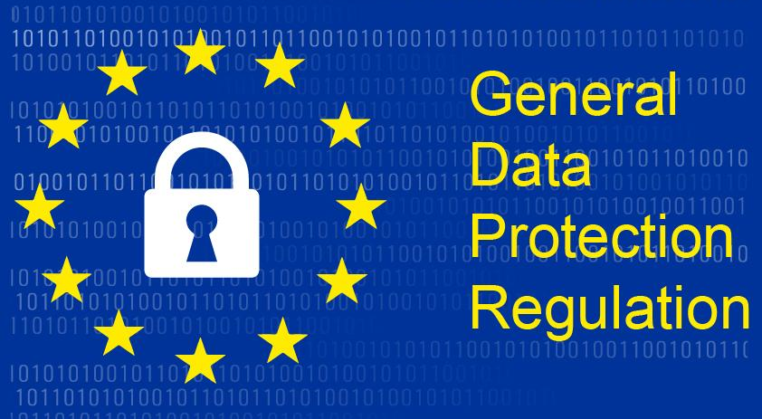
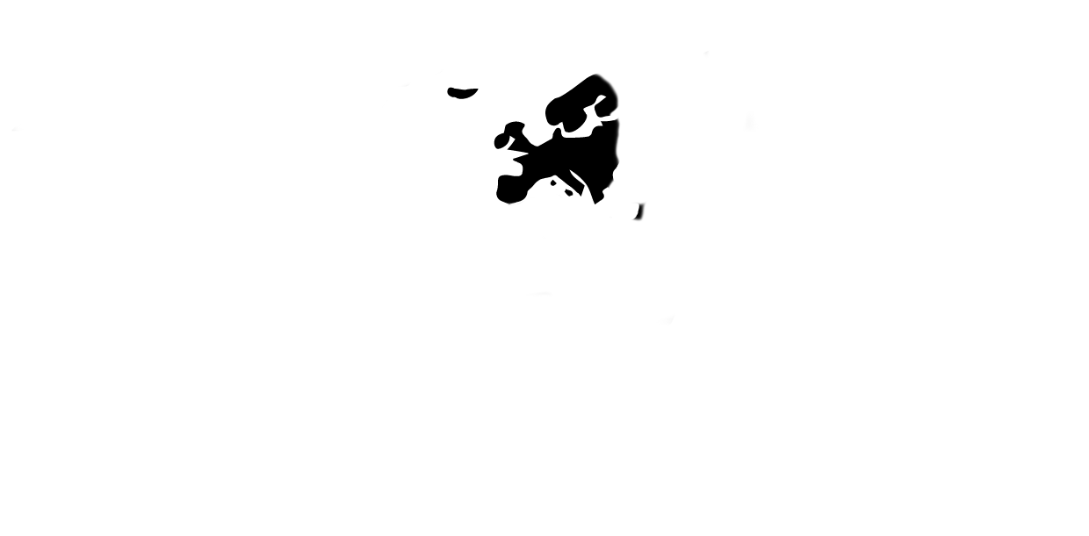

Data Laws and Regulations
Notes:
Under the General Data Protection Regulation (GDPR), the legislative act of the European Union (EU), any organization collecting personal information from residents of any EU country must respect the individual right to privacy by collecting and handling personal data in carefully prescribed ways.
Why should the whole world concern itself with an EU legislation? Because it's predicted that most countries will eventually either adopt the GDPR or create legislations similar to it. In fact, the California Consumer Privacy Act that's slated to come into effect in 2020 has many similarities to the GDPR.
World Map: https://thenounproject.com/search/?q=world+map&i=3090683
GDPR: https://search.creativecommons.org/photos/2ebc46b1-0821-4dbb-8276-3c5f64181789

Slide 4
3 Key Features of Data Protection
Identifiability
Data Minimization
Notice and Consent

Slide 5
1. Identifiability
Aim: Reduce and safeguard identifiable data components as much as possible
De-identification Techniques
Safeguarding Practices
Data Encryption
Storage Location
Anonymization
Pseudonymization
Secure Servers

Slide 6
Levels of Data Classification
Sensitive Data
Genetic, biometric and health data, as well as data that reveals race, ethnicity, political or religious affiliation etc.
Personal Data
Data that includes name and surname, home address, location, email address, IP address etc.
Non-personal Data
Generalized data (e.g. age range), aggregated statistics, data collected by government bodies (e.g. census data), etc.
Notes:
Pyramid re-drawn by Dhilan

Slide 7
2. Data minimization
Aim: Limit data collection and duration of storage to only what is required to fulfill a specific purpose
How long will I need the data to achieve the purpose?
Is there unnecessary data that can be deleted?
How often should I periodically review data and delete what isn’t needed?

Slide 8

Right to be Forgotten (Erasure)
Subjects have the right* to request that their data be erased by the data controller, as soon as possible.
*This right may be overridden in some cases.
What should data collectors do?
Provide subjects with clear information and practical ways to make a request for data erasure
Notes:
compliance with other legal obligations;
a public interest reason in the public health field;
for archiving purposes in the public interest, scientific or historical research purposes or statistical purposes in accordance with Article 89(1) in so far as the right referred to in paragraph 1 is likely to render impossible or seriously impair the achievement of the objectives of that processing; or
DELETE FILE IMG: https://thenounproject.com/search/?q=delete+file&i=2041198

Slide 9
3. Notice and Consent
Aim: Prepare clear notice and consent communication to data subjects
Notice ensures that subjects are aware of the intended data practices
Consent ensures that subjects are only implicated in those practices if they want to be.

Slide 10
Necessary Conditions of Informed Consent
Informed | Subject has sufficient knowledge and comprehension of the matter to enable an enlightened decision | No lies, deceit, or partial disclosure
Voluntary | Subject freely chooses to give consent | No coercion, inappropriate pressure or influence
Competent | Subject has the decisional capacity to offer consent | No children, adults deemed mentally incompetent
Notes:
The basic requirements for the effectiveness of a valid legal consent are defined in Article 7 and specified further in recital 32 of the GDPR. Consent must be freely given, specific, informed and unambiguous. In order to obtain freely given consent, it must be given on a voluntary basis. The element “free” implies a real choice by the data subject. Any element of inappropriate pressure or influence which could affect the outcome of that choice renders the consent invalid.
protection,
autonomy,
prevention of abusive conduct,
trust,
self-ownership,
non-domination, and
personal integrity.

Slide 11
How will data be collected?

Slide 12

Mechanisms for Data Collection
Crowdsourcing
Product users
Paid contributors (mechanical turk)
Notes:
https://thenounproject.com/term/people-search/1151718/

Slide 13
“
...we need to ask which people are excluded. Which places are less visible? What happens if you live in the shadow of big data sets?
”
Kate Crawford
Principal Researcher at Microsoft and Professor at NYU Tandon School of Engineering
Source: “The Hidden Biases in Big Data," Harvard Business Review, April 2013.
Notes:
https://hbr.org/2013/04/the-hidden-biases-in-big-data

Slide 14
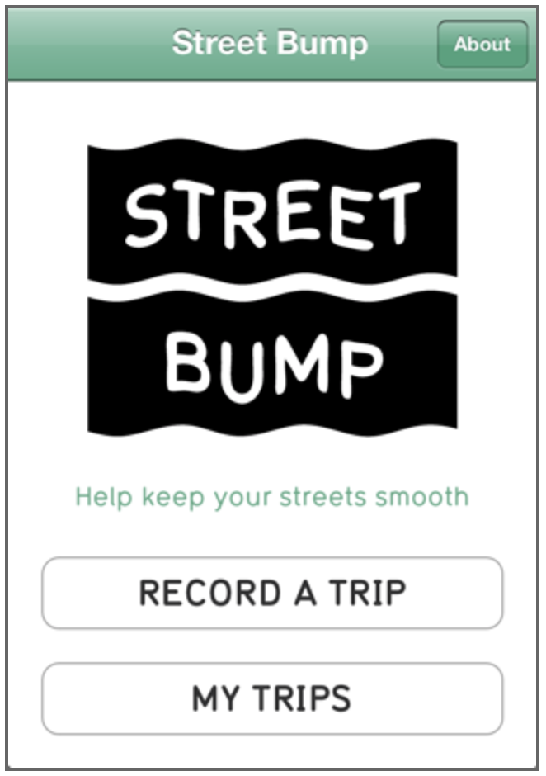
Data Collection: Product Users
Does the demographic of product users accurately represent the population?
Notes:
http://www.streetbump.org/about

Slide 15

Open Datasets
Open source, publicly available datasets to foster innovation and healthy competition!
Accent
23% United States English, 8% England English, 5% India and South Asia, 4% Australian English, 3% Canadian English, 2% Scottish English, 1% Irish English, 1% Southern African, 1% New Zealand English
Age
23% 19–29, 14% 30–39, 10% 40–49, 6% < 19, 4% 50–59, 4% 60–69, 1% 70–79
Source: https://commonvoice.mozilla.org/en/datasets
Notes:
https://commons.wikimedia.org/wiki/File:Common_Voice_Banner.png
https://commonvoice.mozilla.org/en/datasets

